Slide 1
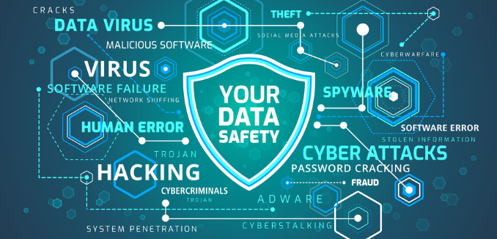

Cyber shield Digital trust and safety
Building a secure and digital future

Slide 2

AIM AND INTRODUCTION
< Create a secure and trustworthy digital future .
<Promote responsible digital citizenship.
<Empower users to protect their personal data
<Educate students on cybersecurity fundamentals.

Slide 3
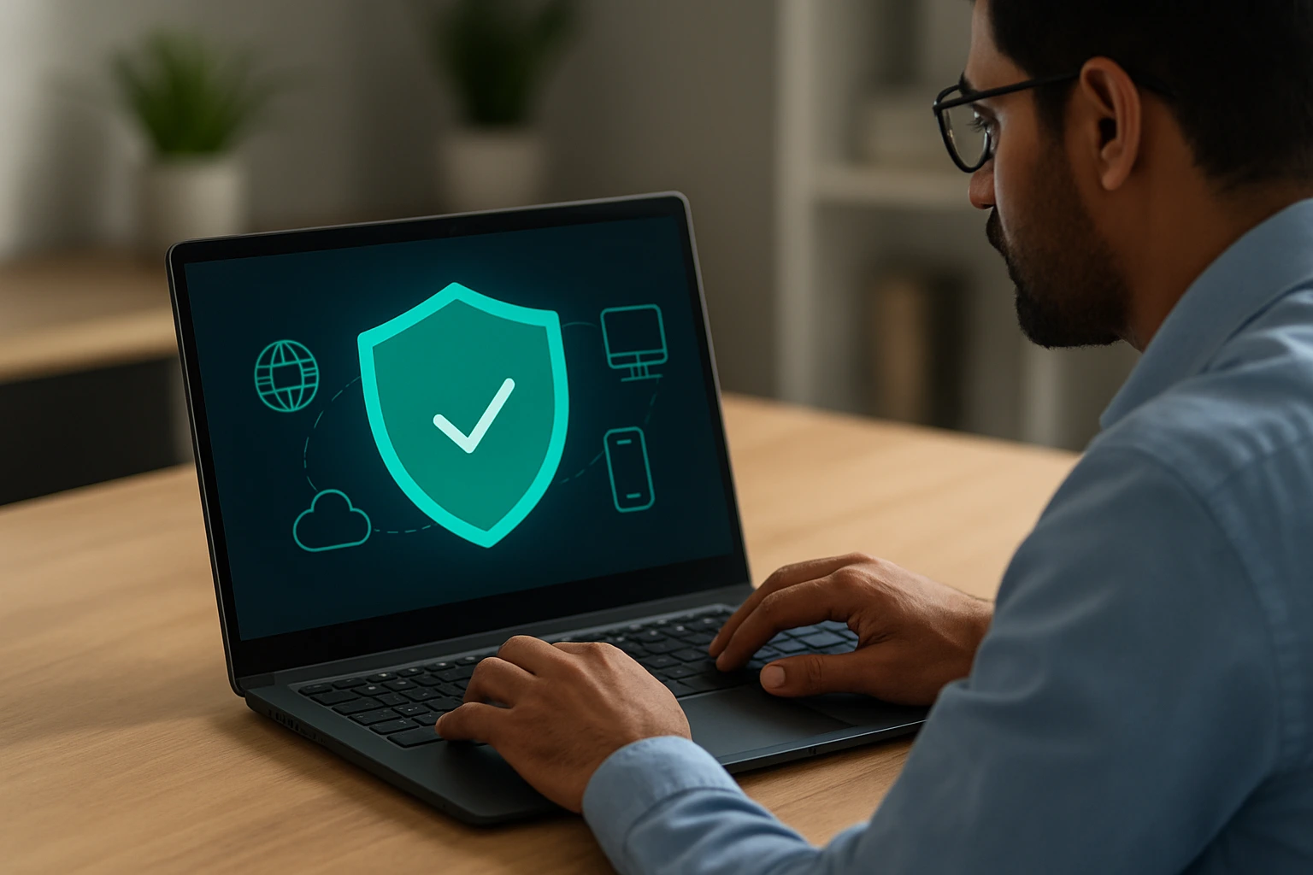
What is cybersecurity ?
Cybersecurity = protecting computers , network and data from attacks
Prevent hacking , data theft and virsues
Use technology ,rules ,awareness and safety habits .

Slide 4
COMMON CYBER THREATS
Phishing
Fake emails/sites asking for passwords and Otps always verify sender and Url.
Malware
Viruses or ransomware that damage devices or lock files .
Identify theft
Someone pretends to be you online Enable 2FA and monitor accounts .

Slide 5
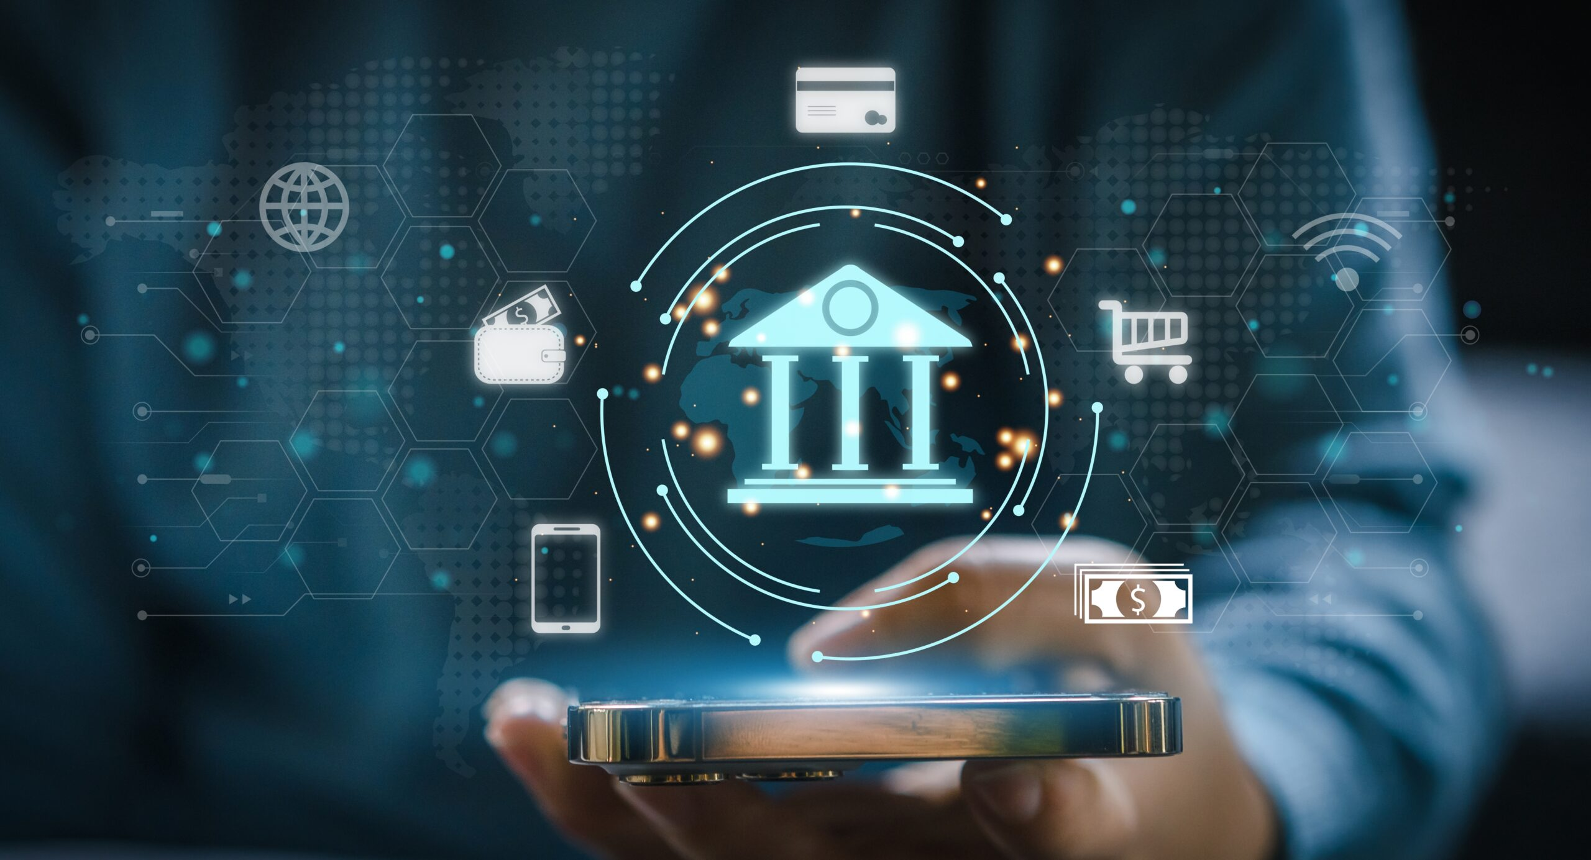
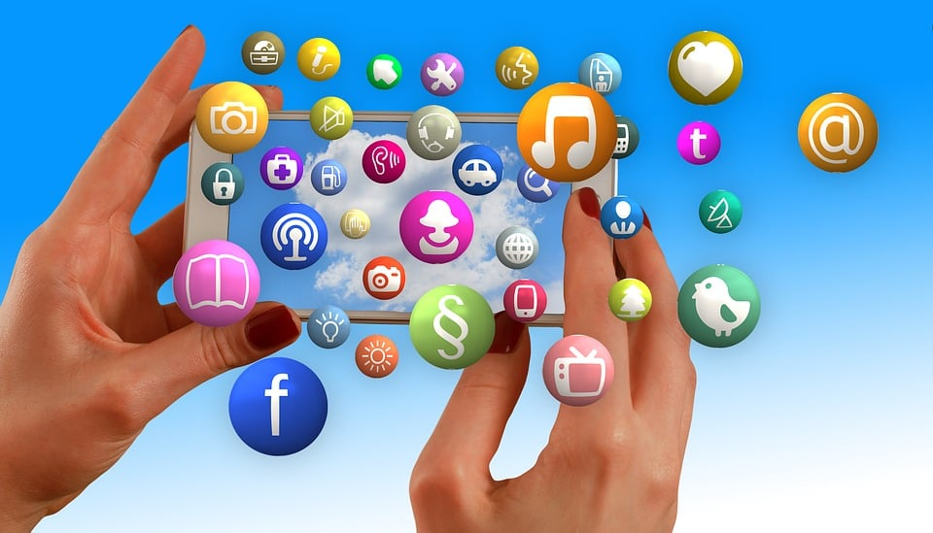
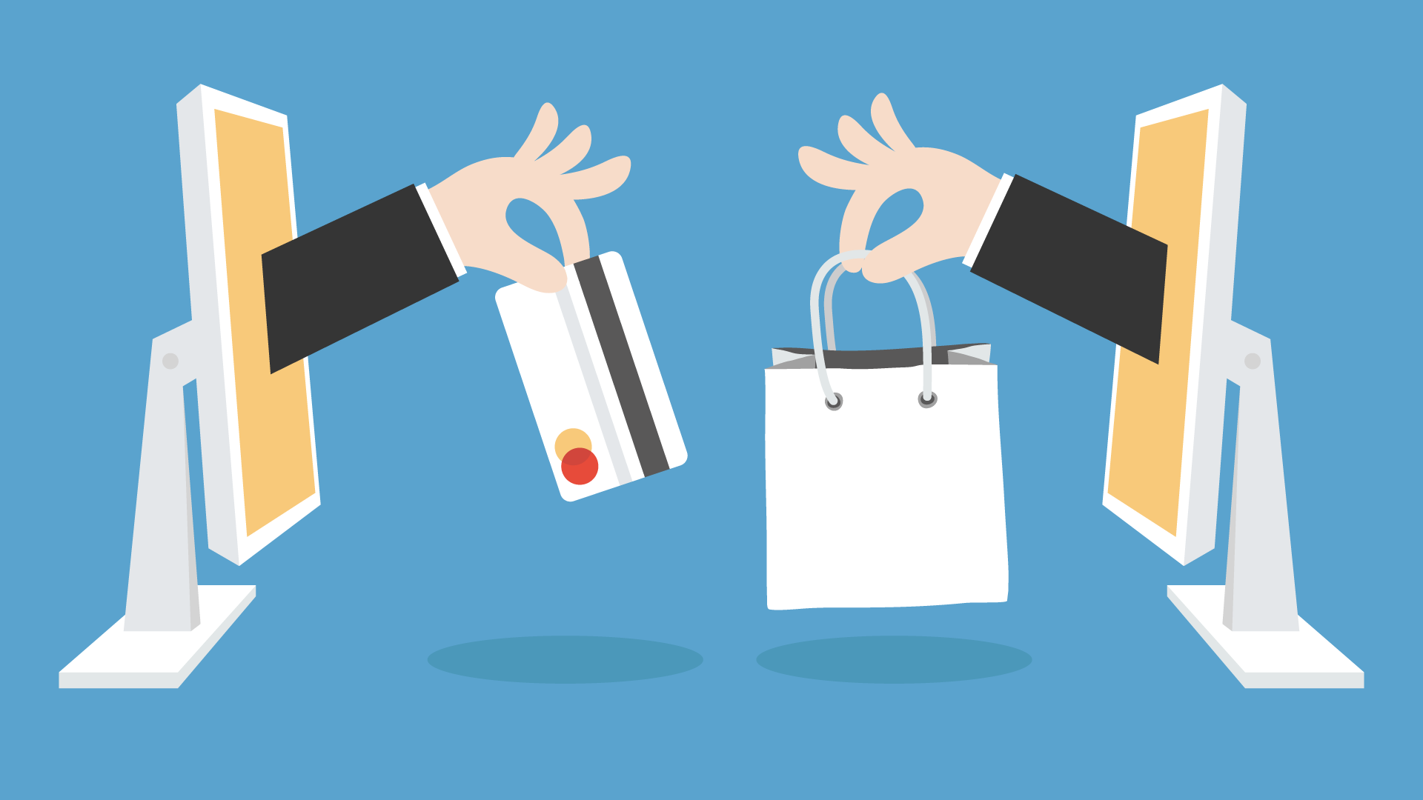
Real life Examples
UPI/Bank frauds cases.
Social media account hacking .
Online shopping scams.

Slide 6
Why digital Trust matters ?
. We share personal data online – photos , passwords , banking info.
.Cyber threats are increasing every year.
.Trust keeps online businesses , payments & communication running .

Slide 7
Building Digital Trust
Use strong ,unique passwords for each account .
Think before cilcking suspicious links .
Be cautions with personal data online
Enable two-factor authenciation everywhere.
Keep software and device updated.
Report suspicious activity promptly.

Slide 8
Safer Internet Practice
Strong Passwords
Use 12+ characters with mixed cases , numbers & symbols.
Two- Factor Authn add a second verification step to all accounts
Think before click verify links before clicking especially urgent ones
Protect data limit sharing ,lock devices ,review permissions.

Slide 9
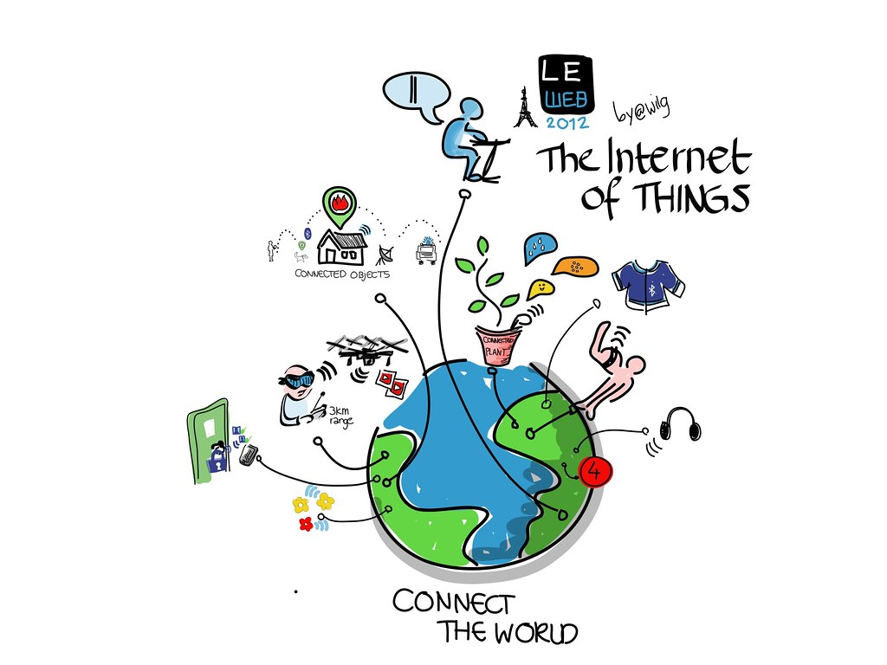
Conclusion
. Internet is powerful but risky .
.Trust ,awareness & cybersecurity go together.
. Safe habits make digital life better.
This Photo by Unknown Author is licensed under CC BY-NC

Slide 10
Thank you for your time and attention….
Presented by : Coder’s Creed
TEAM MEMBER : SADHNA ,RUPALI MEHAK DIKSHA
GOVERNMENT COLLEGE FOR GIRLS ,NACHOLI

